Slide 1

Improvements to CUDA LAP Solver
IE 533 S22
Samiran Kawtikwar (samiran2)
Wes Crevens (wbc3)
Nick Yang (yyang192)

Slide 2
Presentation Outline
Linear Assignment Problem
Hungarian Algorithm for LAP
JVC Algorithm for LAP
Improvements and Results
Reproducible Research and Project Infrastructure
Hungarian Algorithm for the LAP
Hungarian Algorithm for the LAP
Hungarian Algorithm for the L

Slide 3
Linear Assignment Problem
The linear assignment problem is a fundamental problem in combinatorial optimization and has vast applications, e.g., transportation systems, personal assignments, and graph association.
known as the perfect matching problem in bipartite graphs.
Given n resources, n tasks and a cost matrix
Each resource is assigned to one task and each task is assigned to one resources
minimize total assignment cost

Slide 4
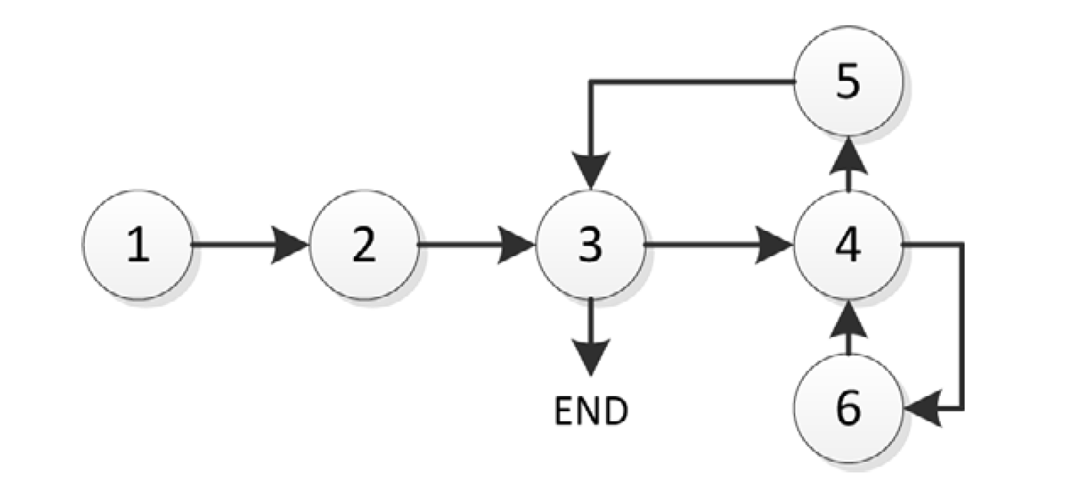

Hungarian Algorithm for the LAP
Developed and Published by, Harold Kuhn (1955)
Original Computational Complexity $Ο(N^{4})$
Has an alternating tree variant of $Ο(N^{3})$
6 step iterative algorithm:
Step 1: Min Reduction
Step 2: Scan zeros (Star Zeros)
Step 3: Column Cover
Step 4: prime non covered zero/s
Step 5: Construct Alternating prime and star zero path (Augment)
Step 6: find the lowest value, subtracting uncrossed rows and adding crossed columns (Dual update)
Flow through several steps of the algorithm

Slide 5
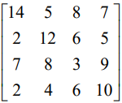
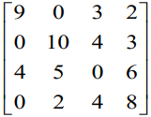
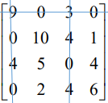
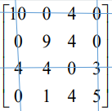
Hungarian Algorithm Example
Row reduction and column reduction
Assignments
x₃₃= 1
x₄₁= 1
x₂₄= 1
x₁₂ = 1
Cost = c₁₂ + c₂₄ + c₃₃ + c₄₁ = 15

Slide 6
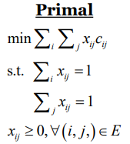
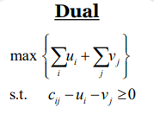
JVC Algorithm for LAP
Published by R. Jonker and A. Volgenant (December 1987)
While Hungarian algorithm finds any feasible augmenting path, Jonker, Volgenant and Castanon (JVC) find the shortest augmenting paths
Step 1 : Initialization
Step 2: Termination, if all rows are assigned.
Step 3: Augmentation
Construct the auxiliary network and determine from an unassigned row i to an unassigned column j an alternating path of minimal total reduced cost and use it to augment the solution.
Step 4: Adjust the dual solution
to restore complementary slackness. Go to step 2

Slide 7
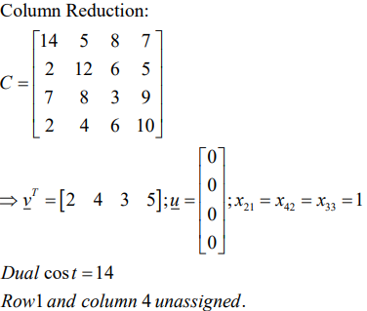
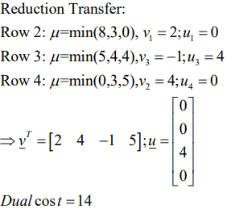
JVC algorithm example
Initialization
Column reduction
each column is assigned to minimal row element
some rows may not be assigned
Reduction transfer from unassigned to assigned rows

Slide 8
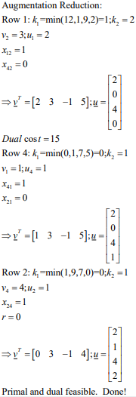
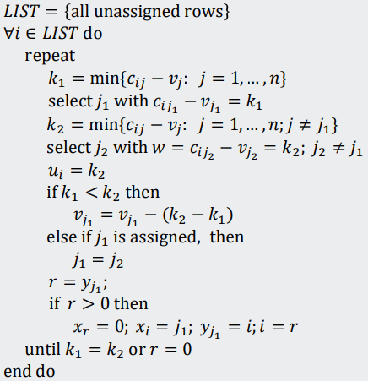
JVC algorithm example
Augmenting reduction of unassigned rows
Complexity of first two initialization procedures is O(n² ), and it can be shown that the augmenting reduction procedure has complexity O(Rn² ), with R the range of cost coefficients

Slide 9
JVC algorithm example
Augmentation
Modified version of Dijkstra’s shortest augmenting path method
Complexity for augmentation phase is O(n³), so this holds for the entire JVC algorithm
Update of the dual solution
After augmentation of the partial assignment, the values of dual variables must be updated to restore complementary slackness, that is,
𝑐_{𝑖𝑘} − 𝑢_{𝑖} − 𝑣_{𝑘} = 0, if 𝑥_{𝑖} = 𝑘 for assigned column 𝑘, 𝑖 = 1, … , 𝑛 and
𝑐_{𝑖𝑘} − 𝑢_{𝑖} − 𝑣_{𝑘} ≥ 0

Slide 10
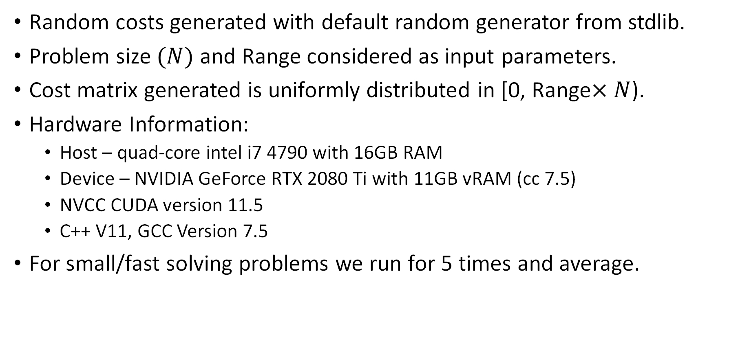
Experimentation setting
Random costs generated with default random generator from stdlib.
Problem size $(N)$ and Range considered as input parameters.
Cost matrix generated is uniformly distributed in [0, Range$×N$).
Hardware Information:
Host – quad-core intel i7 4790 with 16GB RAM
Device – NVIDIA GeForce RTX 2080 Ti with 11GB vRAM (cc 7.5)
NVCC CUDA version 11.5
C++ V11, GCC Version 7.5
For small/fast solving problems we run for 5 times and average.

Slide 11
Baseline Selection
We did an extensive survey of available implementations of linear assignment problem solvers.
These solvers are mainly based on following techniques.
Max flow - (Hungarian Algorithm)
Shortest Path - (JVC, Auction)
Linear Programming - (Specialized versions of Simplex)
Since, our focus was mainly on GPUs, we looked at both sequential and parallel implementations of these algorithms.
Hungarian Algorithm - (Date 16*, Lopes 19*)
JVC - (JVC 70, Guthe 21*)
Simplex - (Gurobi)
Auction - (Bertsekas 81, Pauc 16*)
* cuda implementations

Slide 12
Improvement Attempt - 1
Existing GPU Hungarian algorithms use race conditions for initial cover.
0 |  |  | 0
 |  | 0
 | 0 |  |  | 0
 |  |  | 0 | 0
 |  |  |  |  | 0
 |  |  |  |  |  | 0
 |  |  |  | 0
 |  | 0
0 |  |  | 0
 |  | 0
 | 0 |  |  | 0
 |  |  | 0 | 0
 |  |  |  |  | 0
 |  |  |  |  |  | 0
 |  |  |  | 0
 |  | 0
0 |  |  | 0
 |  | 0
 | 0 |  |  | 0
 |  |  | 0 | 0
 |  |  |  |  | 0
 |  |  |  |  |  | 0
 |  |  |  | 0
 |  | 0
0 |  |  | 0
 |  | 0
 | 0 |  |  | 0
 |  |  | 0 | 0
 |  |  |  |  | 0
 |  |  |  |  |  | 0
 |  |  |  | 0
 |  | 0
0 |  |  | 0
 |  | 0
 | 0 |  |  | 0
 |  |  | 0 | 0
 |  |  |  |  | 0
 |  |  |  |  |  | 0
 |  |  |  | 0
 |  | 0
0 |  |  | 0
 |  | 0
 | 0 |  |  | 0
 |  |  | 0 | 0
 |  |  |  |  | 0
 |  |  |  |  |  | 0
 |  |  |  | 0
 |  | 0

Slide 13
Improvement Attempt – 1 (continued)
Can we do better?
Definitely!
Use Vogel’s regret approach (as used in traditional transportation problem)
Tradeoffs:
Higher initial coverage
Compromise in speed
Inherently Sequential procedure
A middle ground is to check for column regrets in case of race conditions and chose column with highest regret.
0 |  |  | 0
 |  | 0
 | 0 |  |  | 0
 |  |  | 0 | 0
 |  |  |  |  | 0
 |  |  |  |  |  | 0
 |  |  |  | 0
 |  | 0
Initial coverage = 5/7

Slide 14
Improvement Attempt – 1 (continued)
Vogel’s regret approach
Penalty
0 | 79 | 75 | 0 | 29 | 11 | 44 | 0
12 | 44 | 0 | 69 | 88 | 95 | 99 | 12
82 | 0 | 48 | 18 | 0 | 41 | 57 | 0
68 | 69 | 17 | 0 | 0 | 45 | 60 | 17
72 | 18 | 43 | 60 | 9 | 0 | 27 | 9
79 | 91 | 71 | 28 | 74 | 19 | 0 | 19
43 | 81 | 96 | 48 | 0 | 58 | 24 | 24
97 | 25 | 0 | 37 | 53 | 65 | 55 | 25
12 | 18 | 0 | 18 | 0 | 11 | 27
0 | 79 | 75 | 0 | 29 | 11 | 44 | 0
12 | 44 | 0 | 69 | 88 | 95 | 99 | 12
82 | 0 | 48 | 18 | 0 | 41 | 57 | 0
68 | 69 | 17 | 0 | 0 | 45 | 60 | 17
72 | 18 | 43 | 60 | 9 | 0 | 27 | 9
79 | 91 | 71 | 28 | 74 | 19 | 0 | 19
43 | 81 | 96 | 48 | 0 | 58 | 24 | 48
97 | 25 | 0 | 37 | 53 | 65 | 55 | 25
12 | 18 | 0 | 18 | 0 | 11 | 27
0 | 79 | 75 | 0 | 29 | 11 | 44 | 0
12 | 44 | 0 | 69 | 88 | 95 | 99 | 12
82 | 0 | 48 | 18 | 0 | 41 | 57 | 18
68 | 69 | 17 | 0 | 0 | 45 | 60 | 17
72 | 18 | 43 | 60 | 9 | 0 | 27 | 18
79 | 91 | 71 | 28 | 74 | 19 | 0 | 19
43 | 81 | 96 | 48 | 0 | 58 | 24 | 48
97 | 25 | 0 | 37 | 53 | 65 | 55 | 25
12 | 18 | 0 | 18 | 0 | 11 | 27
0 | 79 | 75 | 0 | 29 | 11 | 44 | 0
12 | 44 | 0 | 69 | 88 | 95 | 99 | 12
82 | 0 | 48 | 18 | 0 | 41 | 57 | 18
68 | 69 | 17 | 0 | 0 | 45 | 60 | 45
72 | 18 | 43 | 60 | 9 | 0 | 27 | 18
79 | 91 | 71 | 28 | 74 | 19 | 0 | 19
43 | 81 | 96 | 48 | 0 | 58 | 24 | 48
97 | 25 | 0 | 37 | 53 | 65 | 55 | 25
12 | 18 | 0 | 18 | 0 | 11 | 27
0 | 79 | 75 | 0 | 29 | 11 | 44 | 11
12 | 44 | 0 | 69 | 88 | 95 | 99 | 12
82 | 0 | 48 | 18 | 0 | 41 | 57 | 41
68 | 69 | 17 | 0 | 0 | 45 | 60 | 45
72 | 18 | 43 | 60 | 9 | 0 | 27 | 18
79 | 91 | 71 | 28 | 74 | 19 | 0 | 19
43 | 81 | 96 | 48 | 0 | 58 | 24 | 48
97 | 25 | 0 | 37 | 53 | 65 | 55 | 25
12 | 18 | 0 | 18 | 0 | 11 | 27
0 | 79 | 75 | 0 | 29 | 11 | 44 | 11
12 | 44 | 0 | 69 | 88 | 95 | 99 | 83
82 | 0 | 48 | 18 | 0 | 41 | 57 | 41
68 | 69 | 17 | 0 | 0 | 45 | 60 | 45
72 | 18 | 43 | 60 | 9 | 0 | 27 | 72
79 | 91 | 71 | 28 | 74 | 19 | 0 | 19
43 | 81 | 96 | 48 | 0 | 58 | 24 | 48
97 | 25 | 0 | 37 | 53 | 65 | 55 | 25
12 | 18 | 0 | 18 | 0 | 11 | 27

Slide 15
Improvement Attempt – 1 (continued)
Vogel’s regret approach
Penalty
0 | 79 | 75 | 0 | 29 | 11 | 44 | --
12 | 44 | 0 | 69 | 88 | 95 | 99 | --
82 | 0 | 48 | 18 | 0 | 41 | 57 | 41
68 | 69 | 17 | 0 | 0 | 45 | 60 | 45
72 | 18 | 43 | 60 | 9 | 0 | 27 | 72
79 | 91 | 71 | 28 | 74 | 19 | 0 | 19
43 | 81 | 96 | 48 | 0 | 58 | 24 | 48
97 | 25 | 0 | 37 | 53 | 65 | 55 | 25
12 | 18 | 0 | 18 | 0 | 11 | 27
0 | 79 | 75 | 0 | 29 | 11 | 44 | --
12 | 44 | 0 | 69 | 88 | 95 | 99 | --
82 | 0 | 48 | 18 | 0 | 41 | 57 | 41
68 | 69 | 17 | 0 | 0 | 45 | 60 | 45
72 | 18 | 43 | 60 | 9 | 0 | 27 | 72
79 | 91 | 71 | 28 | 74 | 19 | 0 | 19
43 | 81 | 96 | 48 | 0 | 58 | 24 | 48
97 | 25 | 0 | 37 | 53 | 65 | 55 | 25
12 | 18 | 0 | 18 | 0 | 11 | 27
0 |  |  | 0
 |  | 0
 | 0 |  |  | 0
 |  |  | 0 | 0
 |  |  |  |  | 0
 |  |  |  |  |  | 0
 |  |  |  | 0
 |  | 0
Initial coverage = 7/7
Old coverage = 5/7

Slide 16
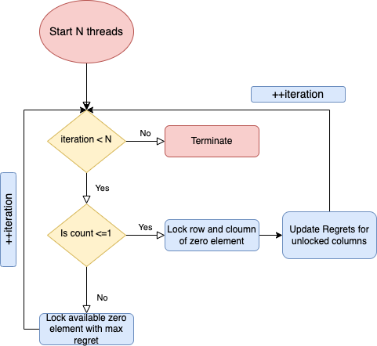
Improvement Attempt – 1 (continued)
Hybrid approach – (Vogel’s regret approach is a bit slow)
2 phase approach
Phase 1 - Dry run
Phase 2 – Lock with regret
 |  |  |  |  |  |  |  | Count
 | 0 | 79 | 75 | 0 | 29 | 11 | 44 | 2
 | 12 | 44 | 0 | 69 | 88 | 95 | 99 | 1
 | 82 | 0 | 48 | 18 | 0 | 41 | 57 | 2
 | 68 | 69 | 17 | 0 | 0 | 45 | 60 | 1
 | 72 | 18 | 43 | 60 | 9 | 0 | 27 | 1
 | 79 | 91 | 71 | 28 | 74 | 19 | 0 | 1
 | 43 | 81 | 96 | 48 | 0 | 58 | 42 | 1
 | 97 | 24 | 0 | 37 | 53 | 65 | 55 | 1
Regret | 12 | 18 | 0 | 18 | 0 | 11 | 27

Slide 17
Improvement Attempt – 1 (coverage strength)
Range 0.01
Range 0.1
Range 1
Size | Baseline | 2 Phase | Vogel
32 | 32 | 32 | 32
64 | 64 | 64 | 64
128 | 128 | 128 | 128
256 | 256 | 256 | 256
512 | 508 | 510 | 512
1024 | 1020 | 1019 | 1024
2048 | 2037 | 2036 | 2048
4096 | 4069 | 4074 | 4096
8192 | 8140 | 8161 | 8192
Size | Baseline | 2 Phase | Vogel
32 | 31 | 31 | 32
64 | 58 | 62 | 64
128 | 119 | 124 | 128
256 | 240 | 246 | 256
512 | 475 | 493 | 511
1024 | 956 | 980 | 1023
2048 | 1909 | 1950 | 2047
4096 | 3821 | 3892 | 4094
8192 | 7608 | 7824
Size | Baseline | 2 Phase | Vogel
32 | 24 | 26 | 28
64 | 47 | 55 | 57
128 | 99 | 112 | 113
256 | 205 | 213 | 225
512 | 402 | 437 | 448
1024 | 801 | 861 | 892
2048 | 1588 | 1705 | 1754
4096 | 3231 | 3446 | 3566
8192 | 6492 | 6888
Range 10
Range 100
Range 1000
Size | Baseline | 2 Phase | Vogel
32 | 26 | 27 | 27
64 | 49 | 53 | 53
128 | 103 | 110 | 110
256 | 197 | 208 | 209
512 | 405 | 421 | 422
1024 | 806 | 849 | 851
2048 | 1593 | 1679 | 1684
4096 | 3144 | 3290 | 3297
8192 | 6348 | 6637 | 6661
Size | Baseline | 2 Phase | Vogel
32 | 26 | 27 | 27
64 | 49 | 52 | 52
128 | 105 | 109 | 109
256 | 196 | 205 | 205
512 | 403 | 421 | 421
1024 | 797 | 846 | 846
2048 | 1588 | 1656 | 1656
4096 | 3194 | 3325 | 3326
8192 | 6345 | 6591 | 6592
Size | Baseline | 2 Phase | Vogel
32 | 26 | 27 | 27
64 | 49 | 52 | 52
128 | 105 | 109 | 109
256 | 202 | 207 | 207
512 | 398 | 417 | 417
1024 | 785 | 809 | 809
2048 | 1591 | 1661 | 1661
4096 | 3209 | 3312 | 3312
8192 | 6351 | 6612 | 6613

Slide 18
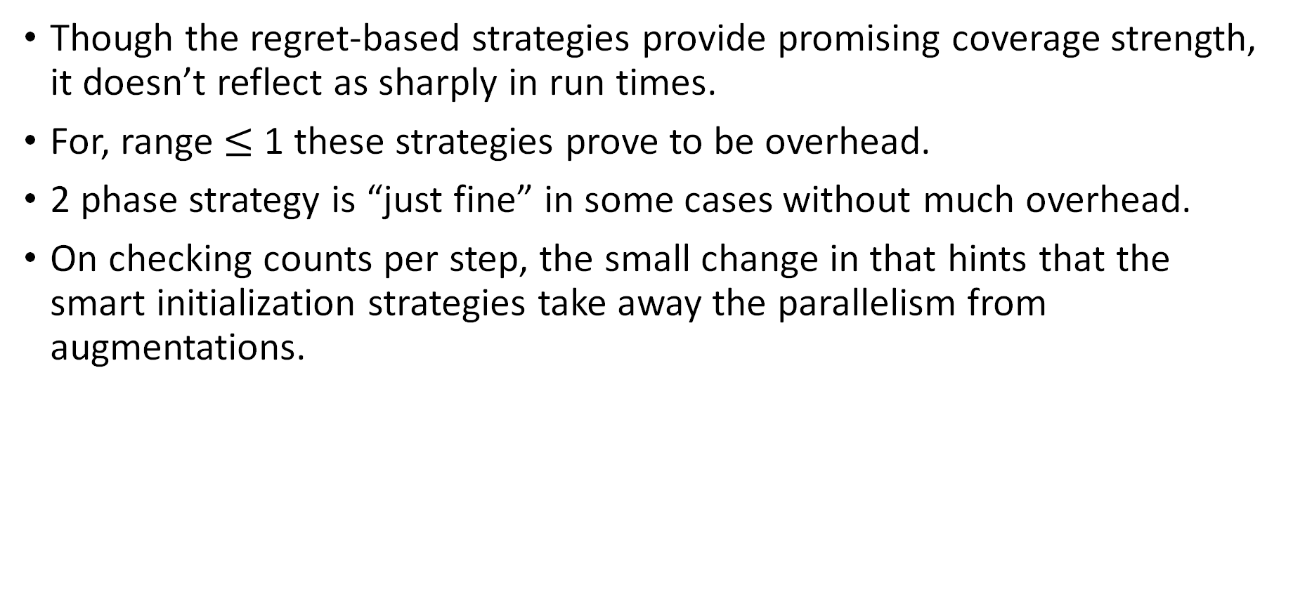
Improvement Attempt – 1 (Total Runtimes)
Though the regret-based strategies provide promising coverage strength, it doesn’t reflect as sharply in run times.
For, range $≤$ 1 these strategies prove to be overhead.
2 phase strategy is “just fine” in some cases without much overhead.
On checking counts per step, the small change in that hints that the smart initialization strategies take away the parallelism from augmentations.
Size | Range | Baseline | 2 phase | Vogel
4096 | 0.01 | 25.84 | 23.25 | 291.25
4096 | 0.10 | 18.70 | 18.14 | 269.58
4096 | 1.00 | 220.47 | 231.73 | 496.35
4096 | 10.00 | 1207.61 | 1145.48 | 1992.75
4096 | 100.00 | 6524.84 | 6720.88 | 15482.30
4096 | 1000.00 | 32261.00 | 32121.00 | 38744.00
Total Times (in ms) for different initialization strategies

Slide 19
Improvement Attempt 2
Used preprocessing ideas from Munapo et. All
Claim to increase parallelism in the LAP cost structure
Though the cost update is only valid when augmentation is done across shortest path.
One augmentation provides multiple pivots, hence the term coined as parallelism.
The idea is best suited for CPU implementation, since shortest paths required and can only do single pivot per iteration.

Slide 20
Improvement Attempt 3
CUDA improvements
Used NVIDIA system profiler to identify bottlenecks in the code and used basic techniques like privatization, kernel fusion etc. to improve performance by upto 7.8x
This improvement also brought light to most time-consuming steps in the implementation.

Slide 21
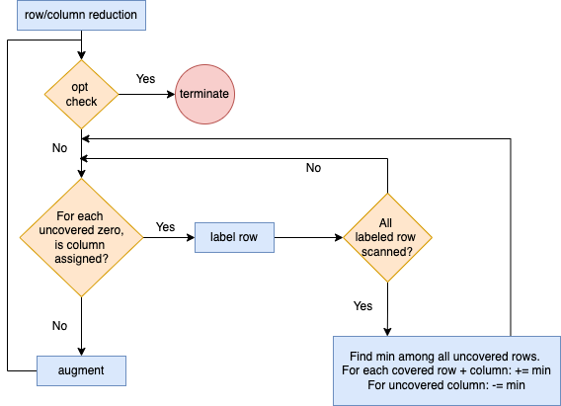
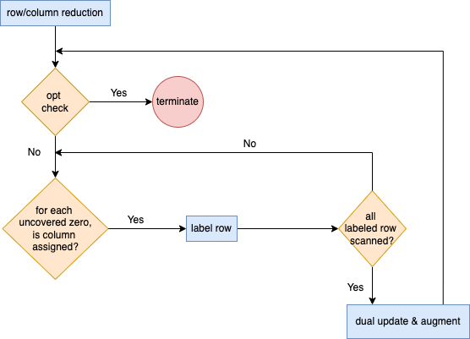
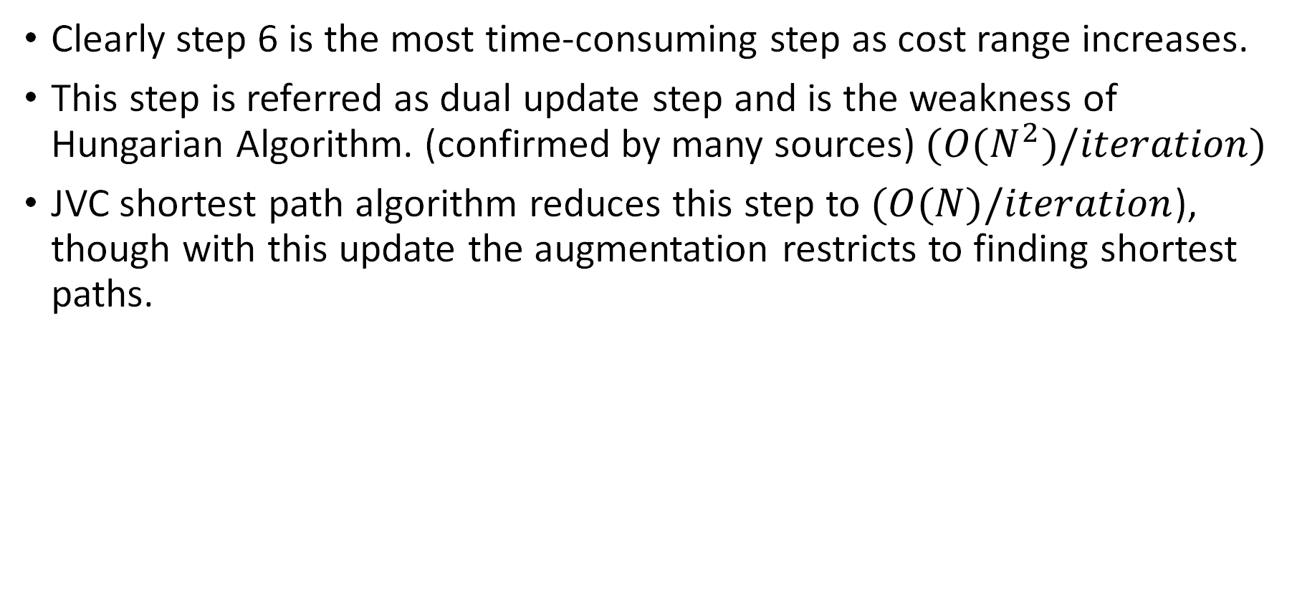
Improvement Attempt 4 - JVC vs Hungarian Algorithm
Clearly step 6 is the most time-consuming step as cost range increases.
This step is referred as dual update step and is the weakness of Hungarian Algorithm. (confirmed by many sources) $(O(N^{2})/iteration)$
JVC shortest path algorithm reduces this step to $(O(N)/iteration$), though with this update the augmentation restricts to finding shortest paths.
Flow of Hungarian Algorithm
Flow of JVC shortest path

Slide 22
Improvement Attempt 4 - JVC vs Hungarian Algorithm
We observe that both problems have very similar structure.
JVC paper uses Augmentation transfer as preprocess for optimizing their run time. Though it is not necessary.
Though a transformation from Hungarian to JVC exists, finding shortest augmenting paths on GPUs is difficult.
Guthe et. All in a recent paper (2021), implemented shortest augmenting paths over GPU, thought the performance is slower than CPU in many cases.*
*After ignoring epsilon scaling improvements

Slide 23
Improvement Attempt 4 - JVC vs Hungarian Algorithm
Due to the parallelism offered, Hungarian algorithm performs better for low range matrices while JVC performs well for High range (Dense) cost inputs.
Runtime trend of different algorithms wrt range, N = 4096

Slide 24
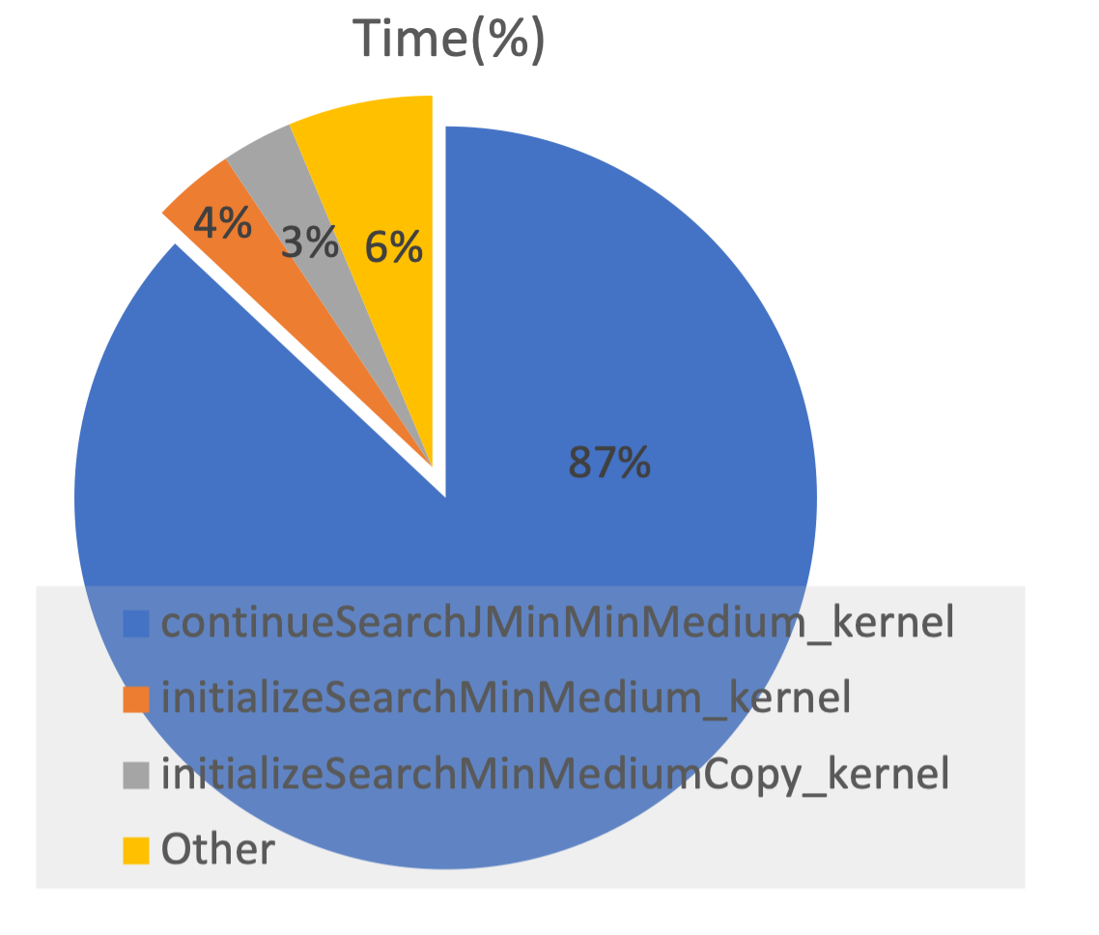
Improvement Attempt 4 - JVC vs Hungarian Algorithm
Shortest augmenting path finding dominates runtime in the GPU implementation of JVC.
Hints towards, shortest path better to be done on CPU for JVC.
This improvement is not fully implemented and explored.

Slide 25
Final results and Conclusion
We have significantly improved state of the art implementation for linear assignment problem for low range matrices.
Name | 64 | 128 | 256 | 512 | 1024 | 2048 | 4096 | 8192
Gurobi | 8.44 | 32.65 | 151.95 | 706.99 | 3614.36 | 58170.10 | 324376.00 | out of mem
LAP16 | 0.20 | 0.25 | 0.41 | 0.74 | 1.46 | 10.68 | 29.26 | 58.21
JVC_cpu | 0.16 | 1.34 | 2.69 | 4.41 | 26.32 | 125.49 | 474.60 | 1842.94
JVC_gpu | 174.00 | 164.00 | 177.00 | 190.00 | 201.00 | 279.00 | 521.00 | 1452.00
LAP19 | 0.37 | 0.44 | 0.56 | 1.03 | 2.20 | 3.64 | 18.79 | 43.11
Our code | 0.41 | 0.57 | 0.62 | 3.49 | 4.81 | 3.41 | 7.89 | 16.64
speedup | 0.39 | 0.45 | 0.66 | 0.21 | 0.30 | 1.07 | 2.38 | 2.59
We achieved Geo mean speedup of 2.62x for problem size 8192 wrt the best performing competitor algorithms!
Name | 64 | 128 | 256 | 512 | 1024 | 2048 | 4096 | 8192
Gurobi | 10.93 | 33.17 | 258.19 | 509.85 | 2466.77 | 11718.00 | 95954.10 | out of mem
LAP16 | 0.51 | 0.25 | 0.42 | 3.23 | 4.75 | 8.54 | 22.94 | 56.57
LAP19 | 0.31 | 0.41 | 0.49 | 2.76 | 6.46 | 6.44 | 9.45 | 18.13
JVC_cpu | 0.09 | 0.30 | 1.71 | 6.21 | 19.59 | 92.64 | 411.71 | 1617.43
JVC_gpu | 223.00 | 134.00 | 134.00 | 140.00 | 164.00 | 242.00 | 503.00 | 1436.00
Our code | 1.50 | 0.88 | 1.45 | 2.38 | 2.64 | 6.26 | 5.09 | 9.96
speedup | 0.06 | 0.28 | 0.29 | 1.16 | 1.80 | 1.03 | 1.86 | 1.82

Slide 26
Questions?
Thank you!

Slide 27

Reproducible Research and Project Infrastructure
You can Relax now... we're into the good part.
Note: These slides are not the content (thankfully).
The talking part is the content.
If you would like notes/bullet points/references later just let us know.

Slide 28

Reproducible Research and Project Infrastructure

Slide 29

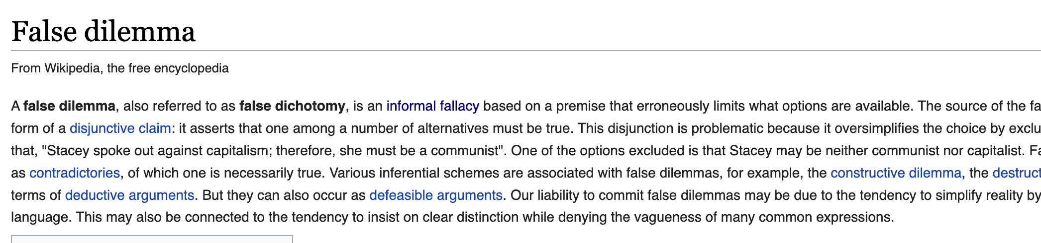
Reproducible Research and Project Infrastructure

Slide 30


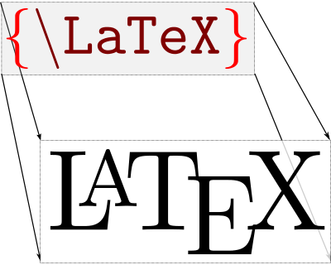



Reproducible Research and Project Infrastructure
…

Slide 31




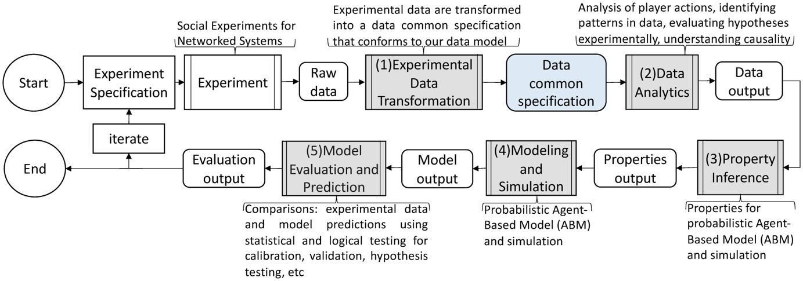
Reproducible Research and Project Infrastructure

Slide 32
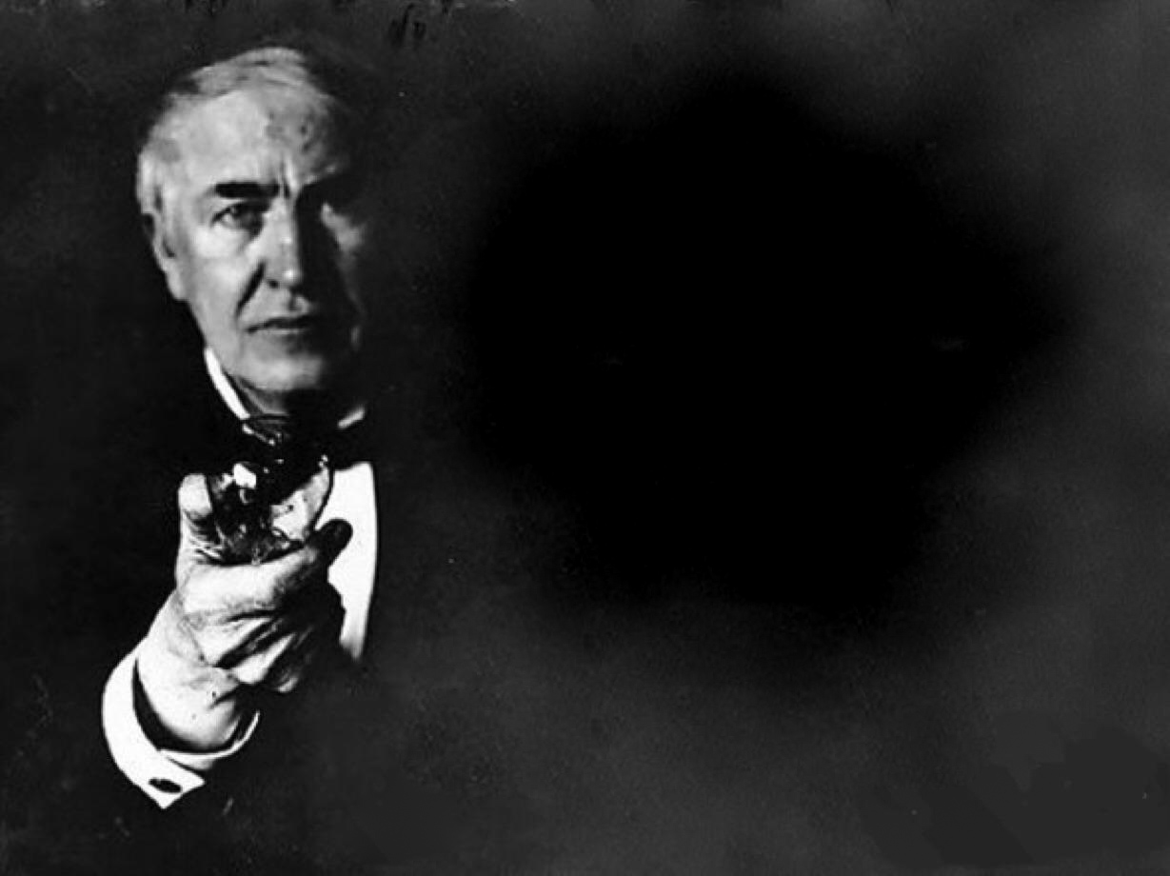
Reproducible Research and Project Infrastructure

Slide 33
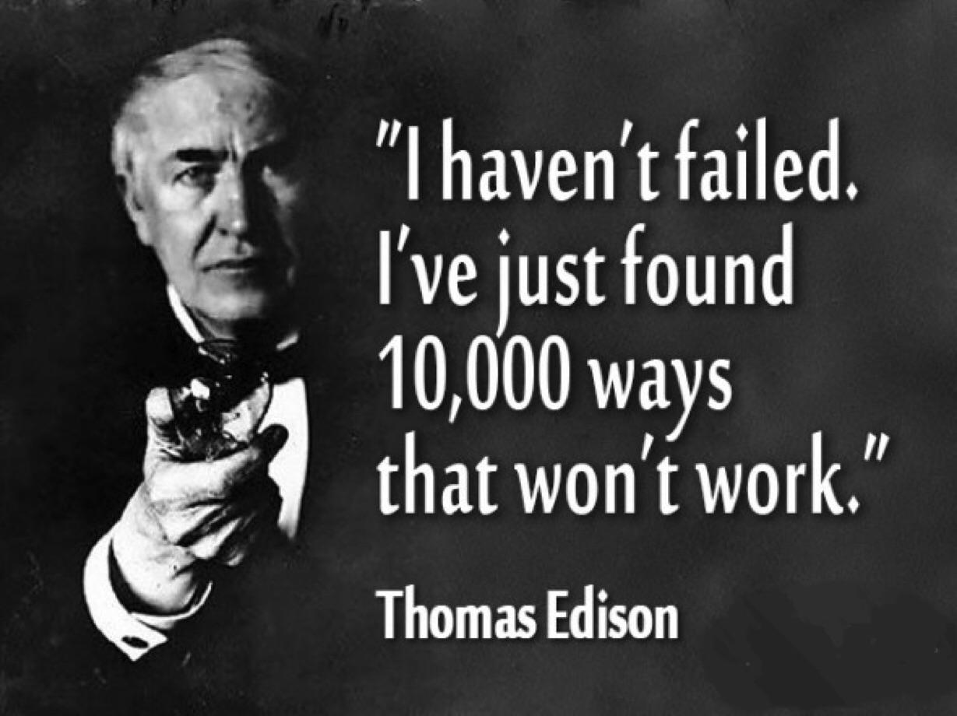
Reproducible Research and Project Infrastructure

Slide 34

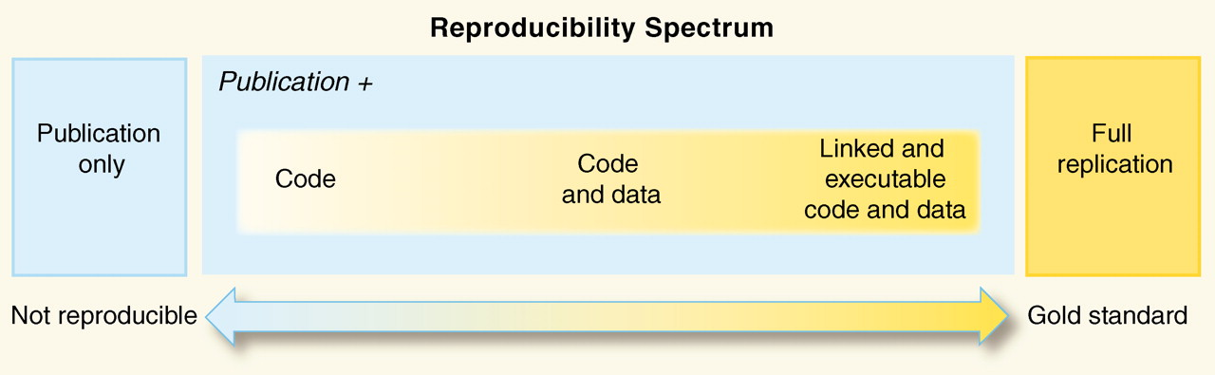
The Red Shiny Button
SCIENCE • 2 Dec 2011 • Vol 334, Issue 6060 • pp. 1226-1227 • DOI: 10.1126/science.1213847

